Slide 1
Photometric Properties of Galaxies
To measure the brightness distribution of galaxies, we must determine the surface brightness of the resolved galaxy.
Surface brightness = magnitude within 1 square arcsecond of angular area on the sky (μ_{B}(R)) or flux units (I_{B}(R)) and is independent of distance since light flux falls as 1/d², but the area subtended by 1 arcsec² increases as d².
(though cosmological dimming of 1/(1+z)⁴ causes higher z galaxies to have lower surface brightness)
15
Much of the galaxy structure is fainter than the sky, which must be accurately subtracted.
Night sky at 22.7
μ_{B}
20
25
30
radius
Notes:
BM Ch 4.2-4.3, SG 6.1

Slide 2
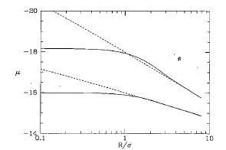
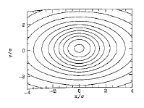
Surface brightness profiles are produced by azimuthally averaging around the galaxy along isophotes - lines of constant brightness. These are projected SB profiles.
Seeing effects on SB profiles - unresolved points are spread out due to effects of our atmosphere – these effects are quantified by the Point Spread Function (PSF)
-makes central part of profile flatter
-makes isophote rounder
Profiles and isophotes for galaxies observed with seeing conditions characterized by a Gaussian PSF of dispersion σ

Slide 3
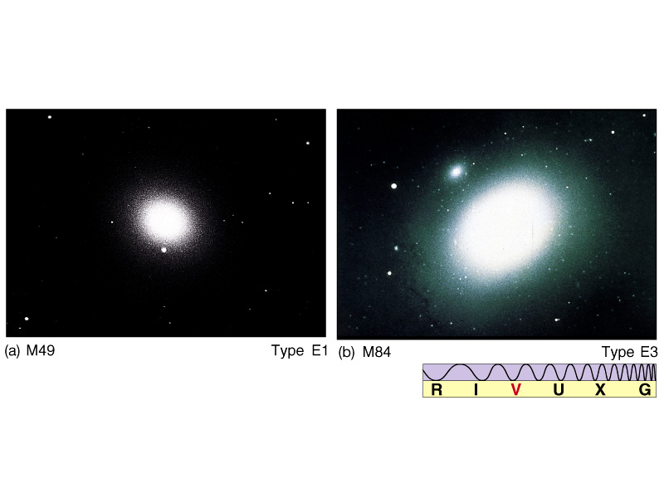
Elliptical Galaxies (and bulges of Spirals)
μ_{B} ~ yR^{1/4}
μ_{B}
R^{1/4}
μ = μ_{e} – 8.325 + 8.325(R/R_{e})^{1/4}
I(R) = I_{e} exp{-7.67[(R/R_{e})^{1/4}-1]} “deVaucouleurs law” (1948)
or “r^{1/4} law”
R_{e} = effective radius containing 50% of luminosity R_{e} = (a_{e}b_{e})^{1/2}
(factor of 3.33 makes this work) -for major,minor axis
I_{e} = surface brightness at R_{e} I_{o} = I_{e}10^{3.33} = 2138I_{e} (central flux)
Notes:
mu1-mu2 = 2.5 log (I2/I1) → I2/I1 = 10^(-0.4*(mu2-mu1))

Slide 4
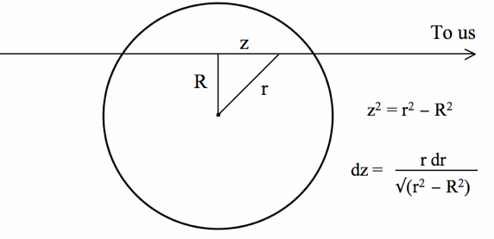




Surface photometry and deprojecting galaxy images
Can we infer the 3-d luminosity density j(r) in a transparent galaxy from its projected surface-brightness distribution I(R)?
If I(R) is circularly symmetric, j(r) may be spherically symmetric:
Abel integral equation with solution
See BT 4.2
→

Slide 5
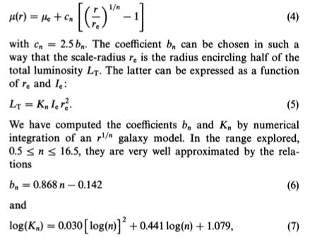

Other model fits to Elliptical profiles…
King models (1966) are a theoretically-based family of models derived from light distribution of a quasi-isothermal sphere of stars and a tidal truncation at large radii.
I(R) = I_{o}{[1+(R/R_{c})²]^{-1/2} - [1+(R_{T}/R_{c})²]^{-1/2}}²
radius where I=1/2 I_{o} R_{T}=cR_{c}
Sersic models (1968) have been shown (Caon et al 1993) to be an even better fit to E’s, though increases # of free parameters:
We find some physical relationships between n and other global properties of Ellipticals.

Slide 6
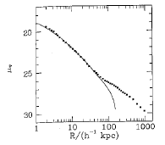
Although r^{1/4} and r^{1/n} laws are empirical, some dynamical studies reproduce these stellar distributions. N-body simulations show that r^{1/4}–like distributions form when a cloud of stars relaxes from a cold, clumpy, initial configuration (e.g. galaxy mergers; Hopkins et al 2009)
Globular clusters also follow r^{1/n} but have different internal dynamics.
dE’s are more diffuse and have shallower SB profiles.
Deviations from r^{1/n} fits:
cD galaxies - extended power-law envelopes seen predominantly in dominant cluster galaxies
Found in regions of high density
Extremely high luminosity (4x10¹⁰L)
Unusual profiles caused by remnants of captured galaxies OR
Envelope belongs to the cluster of galaxies (not just central galaxy) -- ellipticity of envelope follows curves of constant # density of galaxies
Multiple nuclei common
Notes:
MW ~ 2 x 10^10 L_sun

Slide 7
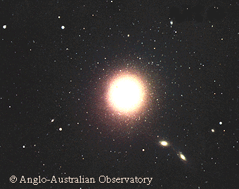
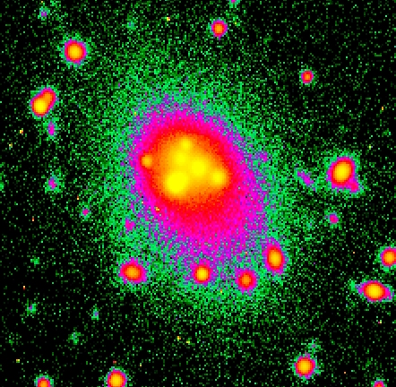
cD galaxy M87 in the Virgo cluster
Abell 3827 cD galaxy

Slide 8
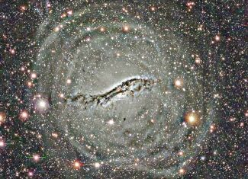
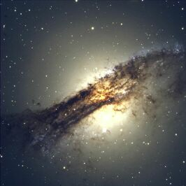
Shells - seen at faint levels around some E’s
  Origin could be merger remnants or captured satellites
  Galaxies w/ prominent shells show evidence for some young stars in the galaxy
Shells in Cen A
…and dust
Dust - visible dust clouds seen in many nearby E’s (~50% have some dust)
Tidal Truncation - outer regions decrease faster than R^{1/n} → tidal stripping ?

Slide 9
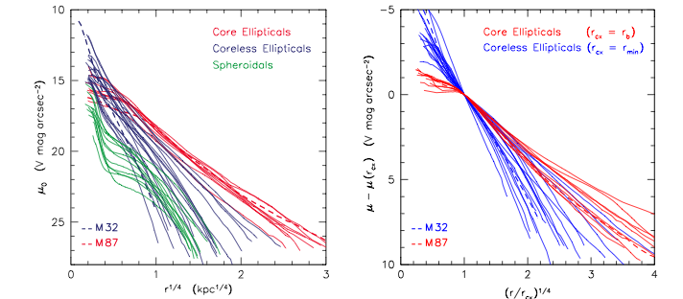
Centers of Elliptical Galaxies
R^{1/4} and Sersic fits tend to fail in the inner regions of Ellipticals
Regions of special interest because they host supermassive black holes
HST is necessary since largest E’s lie far away and seeing effects degrade profile centers
Lauer et al (1995) first identified dichotomy in inner profiles
More luminous E’s (M_{v}<-21.7) tend to have cores – flatten towards center
Midsize E’s (-21.5<M_{v}<-15.5 with L<2x10¹⁰L) are core-less; steeply rise to center
Core could be the result of mergers making central nucleus more diffuse – caused by binary BHs scouring out centers in “dry mergers” (no gas)
Core-less also reveal “extra light” which may be result of nuclear starburst resulting from “wet mergers” (with gas) - see Kormendy et al 2009 (K09)

Slide 10
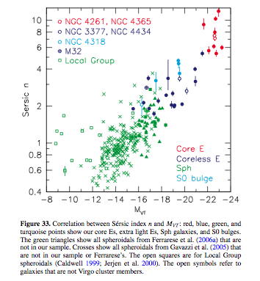
K09 show that:
giant E’s (core) have n>4
mid-size E’s (coreless) have 1<n<4
Sersic parameter relates to galaxy magnitude and core presence

Slide 11
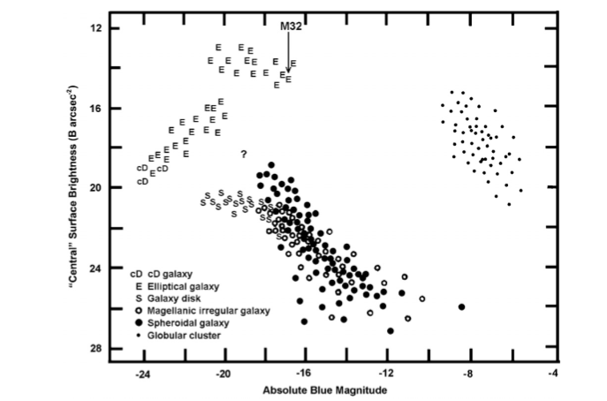
Coreless
Core
Brighter central surface brightness →
← Brighter total galaxy light

Slide 12
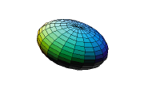
3-D Shapes of Ellipticals and Bulges
What are the true shapes of surfaces of equal luminosity density (isodensity)?
1st order model assumes either prolate (football) or oblate (flattened) spheroids (see SG 6.1.1. for discussion)
But most giant E’s seem to be triaxial ellipsoids
  All 3 axes different lengths
  No axis of rotational symmetry
http://mathworld.wolfram.com/Ellipsoid.html

Slide 13
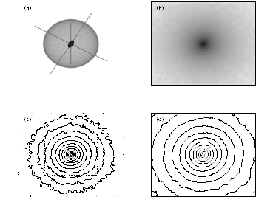
Evidence for triaxial bodies: Isophotal twists and changing ellipticity with radius
  A triaxial body viewed from most orientations will have twisted isophotes from all viewing angles except along principal axes (i.e. PA changes with radius)
Surface of constant density. The outer surface is oblate with x:y:z = 1:1:0.46. The inner surface is triaxial with x:y:z = 1:0.5:0.25.
Projected SB
Isophotes of SB
Isophotes of central region - note isophotal twists
Triaxial bodies generally show a change in the ellipticity of isophotes as a function of radius
ε
radius

Slide 14
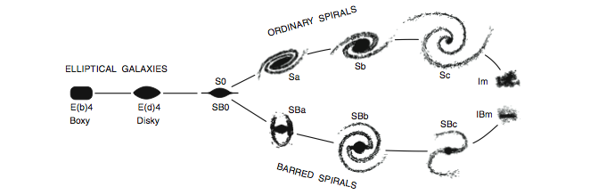
“boxy” or “disky” isophotes
  80% of E’s show systematic deviations from pure ellipses
  These ~1% level deviations can be parameterized by decomposing the isophotal profiles into higher order terms (fourier series expansion in azimuth)
I(θ) = a_{o} + a₂cos2θ + a₄cos4θ
ellipse “a4” component
...a modification to the tuning fork...

Slide 15

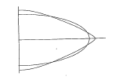
“boxy” or “disky” isophotes
a₄=0 pure ellipse
a₄<0 “boxy”
Caused by a variety of orbit populations in galaxy (merger?)
Have lower overall rotation
Stronger radio and X-ray sources (emission from hot gas)
Most luminous E’s
Most likely to have isophotal twists
a₄>0 “disky”
Possible indication of the presence of a weak, edge-on disk
Partially rotationally supported
Not strong radio or X-ray sources
Most mid-size E’s

Slide 16
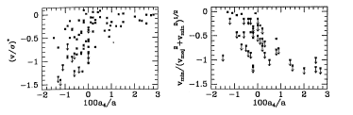
Boxy galaxies are triaxial systems with little net rotation
Disky galaxies are closer to oblate spheroids with significant rotational support
Higher rotational velocity
boxy
disky
disky
boxy
Higher random velocity
(BM Fig 4.39)
Higher velocity gradient along major axis
V = rotational velocity
σ = velocity dispersion (random velocities)

Slide 17
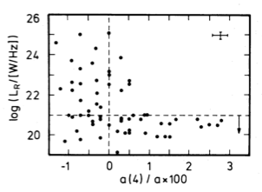
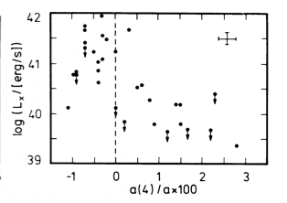
Radio
X-ray
boxy
disky
disky
boxy
(Bender et al 1989)
Stronger radio and X-ray emission found among E’s with boxy isophotes (X-rays from hot gas) than disky ones → why?
Merrifield (2004) – E’s with active nuclei (central SMBHs accreting material from surrounding area - AGN) are less rotationally supported, while E’s with inactive nuclei (dormant SMBHs) span a range of rotational support values → related to accretion onto SMBH?
Notes:
Triaxiality of galaxy’s potential facilitates exchange of ang mtm between stellar component and ISM – heats gas
More disky – forms centrifugal barrier prevents ISM gas from getting to nuclear regions

Slide 18
More on Elliptical galaxy SB correlations….
Bekki & Shioya 1997
Disky E’s generally have moderate L
formed by mergers with less rapid SF due to lower mass
gradual depletion of gas
results in compact center, coreless profile
Boxy E’s generally have high L
formed by mergers with rapid SF
rapid depletion of gas
less compact centers, shallower profiles →“cores”
K09
Boxy/Giant E’s/Core/large n – formed in dissipationless (dry) mergers
Ellipticals merge and form binary BH which scours out central stars
X-ray bright (hot gas present and maintained through
random orbits and AGN feedback)
Hot gas prevents SF – keeps gas from dissipating to center for SF
Disky/Mid-size/Coreless/smaller n – formed in dissipational (wet) mergers
Galaxy merger with total mass too low to retain hot gas (X-ray weak)
AGN feedback weaker → allows for nuclear SF

